Slide 1
Random Forest
Random Forest is an ensemble learning algorithm that builds multiple decision trees using bootstrapped datasets and random feature selection, and combines their predictions to improve accuracy and reduce overfitting.

Slide 2
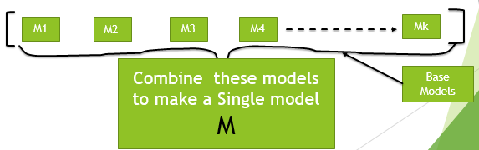
What are Ensembles ?
The word “Ensemble” is taken from music background which means: Group of Musicians.
Similarly, In machine learning, ensemble modeling leverages the "wisdom of the crowd" by combining multiple models to make more accurate predictions, rather than relying on a single model.
This approach harnesses the collective strength of diverse models to improve performance and reduce errors.

Slide 3
Types of Ensembles Models
Bagging : Also called Bootstrap Aggregation: Random Forest
Boosting : Ada boost, Gradient Boosting, XG Boost
These are high performing model
These models are very powerful and popular.

Slide 4
Key Idea:
When different models are giving different level of accuracy than it would be better to combine them and make predictions.

Slide 5

Bagging
It is also called bootstrap aggregation: Means sampling with replacement.
If decision tree suffered from problem of overfitting we can use concept of bagging.
Where overfitting means your model have good training accuracy but poor testing accuracy, in general thumb rule if difference between training and testing accuracy is more than 10 % we can say it is over fitted.
Random Forest is the most popular implementation of Bagging used in real-world applications.

Slide 6

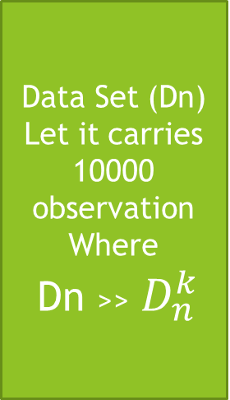



Bagging Architecture
Bootstrapping
Regression : Averaging
$$D_{n}^{1}$$
M1
Data Set (Dn)
Let it carries
10000 observation
Where
Dn >>${ D}_{n}^{k}$
$$D_{n}^{2}$$
M2
M
$$D_{n}^{3}$$
M3
Classification: Voting
$$D_{n}^{k}$$
Mk

Slide 7
Bootstrapping
Bootstrapping means taking multiple random samples from data with replacement.
Train separate model on each sample.
This whole approach is called bootstrapping.
Aggregation
Now aggregate the results as model M.
For regression model take the average.
For classification model go for voting.
Bagging is especially effective for reducing variance in high-variance, low-bias models (e.g., deep decision trees).
It does not inherently address bias, so if the base model is underfitting, bagging won't help much.
So Bagging reduces variance without impacting the bias(under fitting).

Slide 8
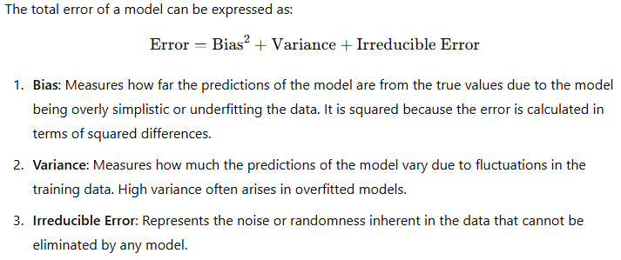
General Error Decomposition

Slide 9
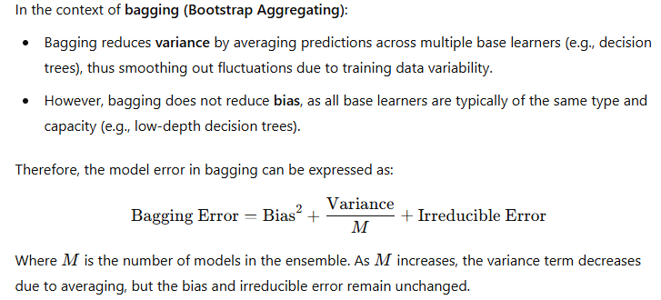
Bagging and Model Error

Slide 10
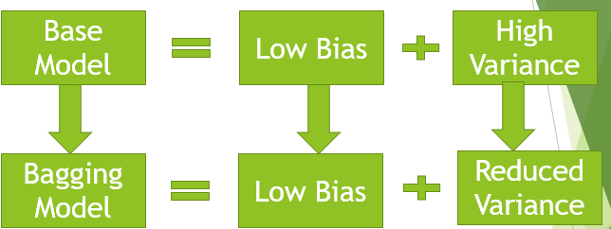

Slide 11
So to handle low Bias and high Variance problem we have popular Bagging model.. Random Forest let us discuss it now……

Slide 12
Introduction
Random Forest is a supervised machine learning algorithm used for classification and regression tasks.
It is a bagging model but differ in a way that it essentially combine only multiple decision trees as base model while in bagging can take any classification model.
It is also called Random Bootstrap sampling.
It operates by constructing multiple decision trees during training and voting the class (for classification) or mean/average prediction (for regression) of the individual trees.
Random Forest reduces overfitting and improves accuracy compared to individual decision trees.

Slide 13
Random Forest Architecture
Decision Tree
Bagging
Feature Sampling
Bootstrap + Aggregation
(Random row sampling)

Slide 14
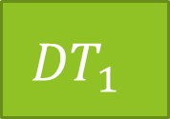
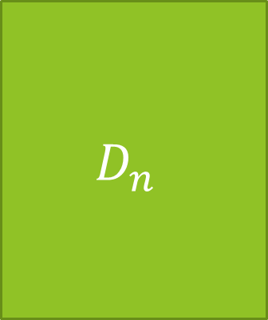
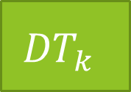
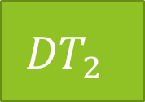
Aggregate
$$D_{n}$$
BS + FS
$${DT}_{1}$$
M1
M
Row
BS + FS
$${DT}_{2}$$
M2
BS + FS
Column
$${DT}_{k}$$
Mk

Slide 15
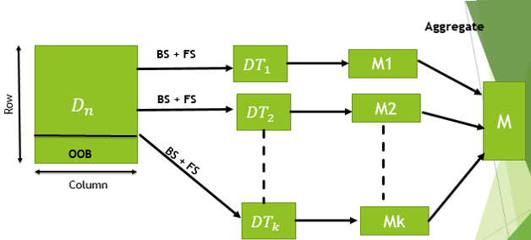
OOB : Out of Bag : Means we keep some data hide and not used in training and
will be used for model validation

Slide 16
What is Out-of-Bag (OOB)?
In Bagging (Bootstrap Aggregating), each base model is trained on a random subset of the training data, drawn with replacement. This means that some data points will not be included in the training subset for a particular base model. These excluded data points are referred to as Out-of-Bag (OOB) samples.
Key Features of OOB:
Not Used in Training: For a given base model, the OOB samples are not used during training.
Used for Validation: The OOB samples act as a validation set for evaluating the performance of the base model. Essentially, they provide an estimate of how well the model performs on unseen data without the need for a separate validation dataset.

Slide 17
Key Differences Table
Feature | OOB Samples | Testing Samples
Source | Part of training set (left out) | Completely separate from training
Purpose | Internal validation (during training) | Final model evaluation
Automatically created | Yes (in Random Forest) | No (provided by user)
Used when | During training | After training

Slide 18
In nutshell what RF is doing…..
Step1: Take decision tree of reasonable depth as base learner
Step 2 : Row sampling with replacement
Step 3 : Column Sampling with replacement
Step 4 : Model Building
Step 5 : Aggregation( Based on Majority) : For classification problem Majority voting and for Regression problem based on mean or median.
We are using Random Forest for handling overfitting problem.

Slide 19
Random forest does not require any outlier treatment.
Data balancing required.

Slide 20
Important Random Forest Hyper parameters
Parameter | Meaning
n_estimators | Number of trees
max_depth | Maximum tree depth
max_features | Number of features considered at split
min_samples_split | Minimum samples to split node
min_samples_leaf | Minimum samples at leaf
oob_score | Enable OOB validation

Slide 21
Advantages/Limitations
Advantages
Limitations
Handles non-linear data
Works with large datasets
Robust to noise
Reduces overfitting compared to single tree
Handles high dimensional data
Slower training than single tree
Less interpretable
Large memory usage
Not ideal for real-time prediction if many trees

Slide 22
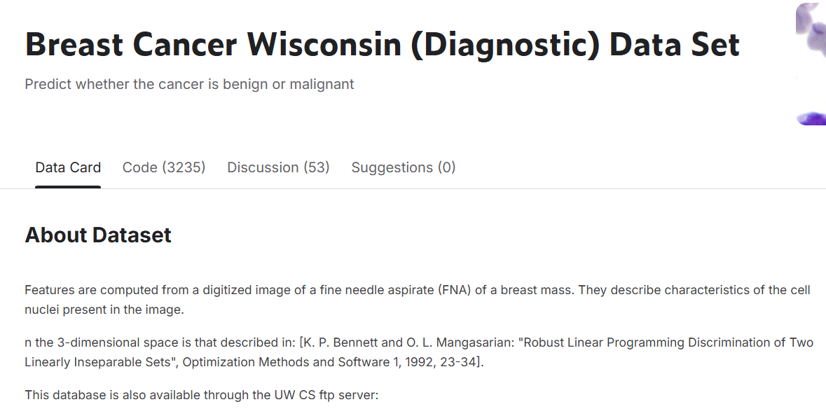
Case study:
Data set: Breast cancer Kaggle uci : https://www.kaggle.com/datasets/uciml/breast-cancer-wisconsin-data

